Slide 1
Aetna Better Health of Michigan Lakeland Care Network Payor Conference October 19, 2022
Aetna Medicaid

Slide 2
ABH-MI Provider Experience Team
Patricia Pogodzinski - Provider Relations Representative
Lawrence Hayes- SR. MGR, Provider Relations
Timothy Burns, Executive Director, Network Medicaid

Slide 3
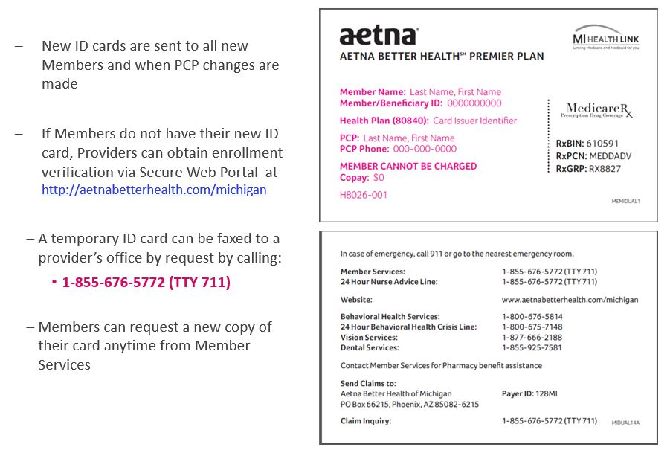
Member Eligibility / Member Identification Cards
You can verify member eligibility, PCP assignment, benefits, co-pays/deductibles by:
Using the State CHAMPS system accessed at www.michigan.gov/medicaidproviders
Provider portal
https://www.aetnabetterhealth.com/michigan/providers/portal
https://Availity.com

Slide 4
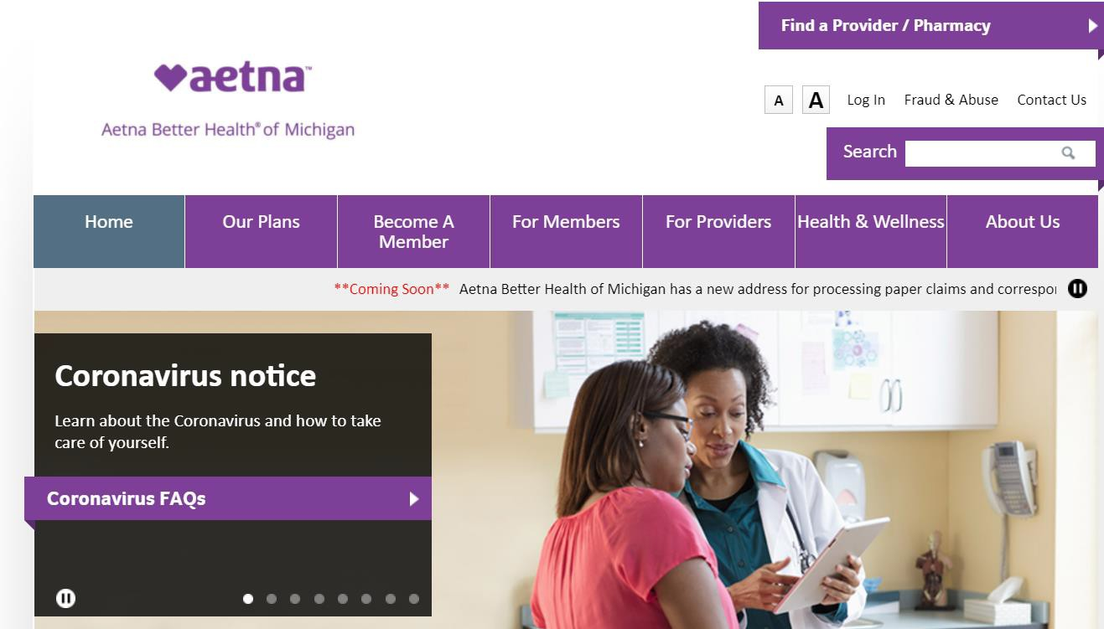
Aetna Better Health of Michigan Website
Providers can access the Aetna Better Health of Michigan website at AetnaBetterHealth.com/Michigan
There you'll find tools and resources to make doing business with Aetna quick and simple. We've listed a few of the tools and resources found on the "For Providers" tab below:
Provider Directory
Provider Manual
Notifications and Newsletters
Authorizations
Document Library
Pharmacy
Practice Guidelines/Screening Tools
Provider Education
Secure Provider Portal
HEDIS
©2022 Aetna Inc.

Slide 5
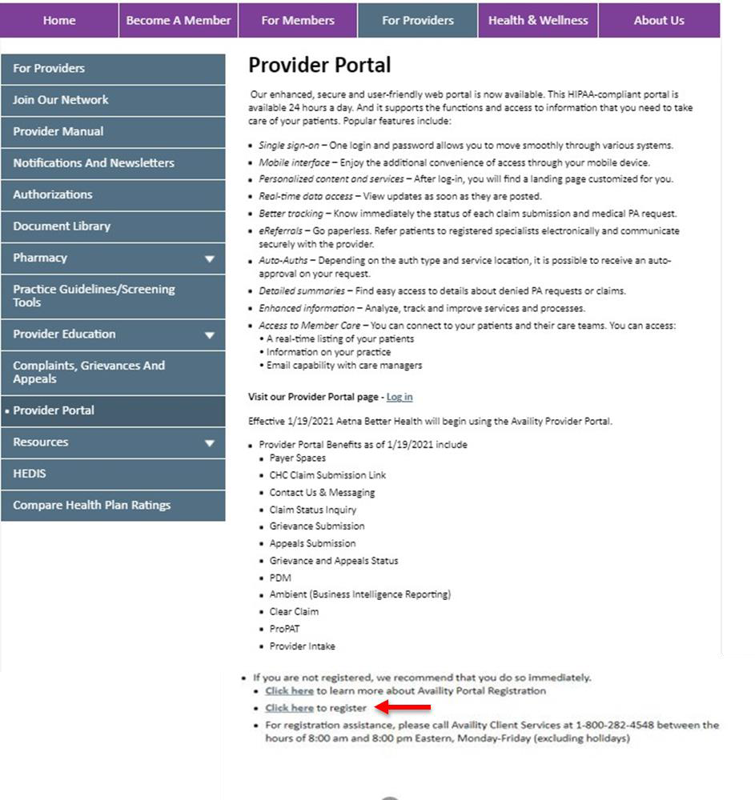
Secure Provider Portal Registration
To register for access to the secure provider portal on Availity, simply follow these four easy steps:
1
Select the For Providers tab on the navigation bar at the top of our website.
2
Select Portalfrom the menu on the left side of your screen.
3
Scroll to the bottom of the page and select Click here to register and follow the on screen prompts to complete your registration.
4
Once logged into the Availity homepage, go to Payer Spaces on the navigation bar. Select Aetna Better Health from your payer list to access all available transactions and features.
©2022 Aetna Inc.

Slide 6
Secure Provider Portal Tools and Resources
Availity Provider Portal benefits include:
Payer Spaces
Claim Submission and Status transactions
Contact Us & Messaging
Grievance and Appeals transactions
PDM
Eligibility and benefits inquiries
Enhanced Grievance & Appeals transactions
Panel roster
Ambient (Business Intelligence Reporting)
Clear Claim
Prior Authorizations tools
Provider Intake
Dynamo (Case Management)
View EOB
Remittance viewer
For registration assistance, call Availity Client Services at 1-800-282-4548 between the hours of 8 AM and 8 PM Eastern, Monday-Friday (excluding holidays)
For access to the following features, please continue to use the Aetna Better Health of Michigan provider portal until they transition to the secure providerportal on Availity:
Remit PDF
Provider Portal Registration Form
Provider Portal Instructions
©2022 Aetna Inc.

Slide 7
Claim Submission
Timely Filing
Our timely filing limitations are as follows:
New Claim Submissions – Claims must be filed on a valid claim form within 365 days from the date service
Providers have 365 days from the date of the remittance advice to submit a Coordination of Benefits (COB) Claim.
Claim Resubmission – Claim resubmissions must be filed within 180 days from the date of payment or denial. (Please submit any additional documentation that may effectuate a different outcome or decision.)
Providers have 180 days from the original denial for appeals and reconsiderations.
20 ©2020 Aetna Inc.

Slide 8
How to File A Claim
Electronic Claims Submissions: Change Health (Emdeon) is the EDI vendor we use Medicare and Medicaid
Paper Claims Submissions: Send the appropriate claim forms to the address below following timely file/billing
guidelines found in the Provider Manuals.
Payer ID: 128MI
Aetna Better Health of Michigan
P.O. Box 982963
EL Paso, TX 79998-2963
Check Claim Status
You can contact Claims Inquiry/Claims Research Phone: 1-866-316-3784
Provider Portal: AetnaBetterHealth-Michigan.Aetna.com
Providers can access the provider portal through a link on the public website at AetnaBetterHealth.com/Michigan
©2022 Aetna Inc.

Slide 9
Remittance advice
Remittance advices are located within the Aetna Better Health of Michigan new provider portal
AetnaBetterHealth.com/Michigan
Electronic Remittance Advice (ERA) are available via your electronic vendor/clearinghouse, if applicable
Claims and remit information will remain available on our provider portal for up to three (3) years
Enrollment Options for EFT/ERA
Online via our Secure Web Portal AetnaBetterHealth.com/Michigan
Call Provider Relations at 1-866-314-3784
©2022 Aetna Inc.

Slide 10
Claim Resubmissions and Reconsiderations
Resubmitted claims must be submitted as a New Claim and can be submitted electronically
Label all corrected claims as “Corrected Claim” on the claim form
Submit all claim lines, not just the line being corrected
Send paper claims for reconsideration with attached documentation to:
Aetna Better Health of Michigan
P.O. Box 982963
EL Paso, TX 79998-2963
Please download and use the Participating Provider Dispute Form on our website AetnaBetterHealth.com/Michigan
©2022 Aetna Inc.

Slide 11
Information Required for Prior Authorization Review & Medical Review
Name, date of birth, and identification number of the member
PCP or treating practitioner
Name, address, phone and fax number and signature, if applicable, of the referring practitioner or provider
Name, address, phone and fax number of the consulting practitioner or provider
Current, applicable codes, which may include:
(CPT)
(ICD-10)
(HCPCS) codes
(NDC)
Problem/diagnosis, including the ICD-10
Reason for the referral
Presentation of supporting objective clinical information, such as clinical notes, clinical notes, comorbidities, complications, progress of treatment, psychosocial situation, home environment, laboratory and imaging studies, and treatment dates, as applicable for the request.
All clinical information must be submitted with the original request.
11
©2022 Aetna Inc.

Slide 12
Requesting Prior Authorization
Aetna Better Health of Michigan requires prior authorization for select services, please refer to our PA tool found on AetnaBetterHealth.com/Michigan under Prior Authorization tab
Submit Prior Authorization (PA)
All Prior Authorization forms must be faxed to 1-866-603-5535 (Medicaid) and 1-844-241-2495 (Duals/MMP Plan).
PA submitted via provider portal website. Provider portal navigation guide is available on our website.
PA request must include the completed authorization form; the supporting documentation, outlined in Information Required for a Prior Authorization Review, including the signed prescription.
Medical services for the treatment of an emergency condition are permitted to be delivered in or out of network without obtaining prior authorization.
12
©2022 Aetna Inc.

Slide 13
Timeframes
Aetna Better Health of Michigan clinical staff will review your request for prior authorization for a member and get back to you according to the following timeframes:
Routine – 14 calendar days upon receipt of request.
Urgent – 72 hours upon receipt of request. An urgent request is appropriate for a non-life-threatening condition, which, if not treated promptly, will result in a worsened or more complicated patient condition.
We encourage you to call the Prior Authorization department at 1-866-874-2567 for all requests or you can fax all
requests to 1-866-603-5535.
For acute inpatient medical admissions, the initial review is to be completed within 72 hours of Aetna Better Health of Michigan’s receipt of notification of admission.
The facility providing the inpatient services should notify the Aetna Better Health Prior Authorization department within twenty-four (24) hours of the member’s placement in inpatient level of care.
13
©2022 Aetna Inc.

Slide 14
Aetna Authorization Tools (PROPAT and EviCore)
PROPAT
Available to providers to determine if PA is required; allows for entry of up to six Current Procedural Terminology (CPT) or Healthcare Common Procedure Coding System (HCPCS) codes or a CPT group and select SEARCH. Search result definitions:
YES - Prior authorization request is required for this service.
NO - Health plan does not require a prior authorization request for this service (PAR Providers Only).
NON-COV - CPT or HCPCS code entered is not a covered benefit by health plan.
INVALID - CPT or HCPCS code entered was invalid, not found.
EXPIRED - CPT or HCPCS code entered is no longer valid for use by health plan providers.
MedicaidPortal.Aetna.com/propat/Default.aspx
EviCore
Healthcare performs utilization management services on behalf of Aetna for Musculoskeletal (pain management) and Radiology Management (includes advanced imaging such as CT, MRI, MRA, PET scans, and diagnostic OB ultrasounds).
For radiology services, submit your PA request directly to EviCore at www.eviCore.com or call 1-888-693-3211
or fax 1-844-822-3862.
14
©2022 Aetna Inc.

Slide 15
Provider Appeals Process
What is a Provider Appeal?
A Provider Appeal is a request to review a denied service. Provider can appeal our decision if service was denied or reduced.
Provider appeals must be received via Fax ,Mail, Email or Secured Web Portal within ninety (90) days of the action taken by Aetna Better Health of Michigan, giving rise to the appeal. Please refer to Chapter 14 of the Provider Manual for additional information.
The appeal letter should clearly note you are filing an “Appeal” on the letter.
All documents to support the appeal should be provided, such as a copy of the claim, remittance advice, medical review sheet, medical records, and other correspondence.
©2022 Aetna Inc.

Slide 16
How to submit a Provider Appeal?
Call: 1-866-316-3784 and press * option and follow prompt.
Fax: 1-866-889-7517
Mail: Aetna Better Health of Michigan Attn: Provider Grievance
PO Box 81040
5801 Postal Road
Cleveland, OH 44181-0040
Email: MIAppealsandGrievances@Aetna.com
Provider Portal : AetnaBetterHealth.com/Michigan/providers/portal
Availity.com
What is the Appeal Decision Response Time?
Pre-service Appeals: within 30 calendar days
Post service Appeals: within 45 calendar days
Appeals are reviewed by a physician not involved in original decision and not subordinate to original decision marker
The Appeal decision is the final decision
©2022 Aetna Inc.

Slide 17
Member Appeals
What is Member Appeals?
A Member Appeal is a request to review a denied service. Member can appeal our decision if service was denied or reduced.
Can Providers file an appeal on member behalf?
Providers can appeal on behalf of Members; However, Authorized Representative Form would be required.
Please attach AOR Form with Appeal.
Members will receive a copy of the decision letter directly when providers appeal coverage decisions on their behalf.
Members enrolled in ABH-MI via Medicaid also have the right to an Administrative Fair Hearing with the Michigan Department of Health and Human Services (MDHHS) at any time. This step should come after First Level Appeal.
©2022 Aetna Inc.

Slide 18
Grievances
Provider Grievances
What is a Provider grievance?
Provider expressing dissatisfaction with member
care, service or processes.
For Example: Provider disagree with TOT for appeal to process.
When should a Provider be grievance be filed?
A Provider has 90 days from the Notice of Action to file a Grievance and 90 days to file a Grievance.
When will a Grievance Decision be completed?
Within 45 calendar days from received date.
Member Grievances
What is a Member grievance?
Member or someone speaking behalf of member expressing
dissatisfaction with member care, service or processes.
For Example: Member disagree with treatment from Dr office or Member was unable to get transportation.
When should a Member be grievance be filed?
A Member can file a grievance at any time.
What should be included in grievance?
All detailed information.
Who, What, When Where and Why?
When will a Grievance Decision be completed?
Within 90 calendar days from received date.
©2022 Aetna Inc.

Slide 19
How to submit a Provider Grievance?
Call: 1-866-316-3784 and press * option and follow prompt. Fax: 1-866-889-7517
Mail: Aetna Better Health of Michigan
Attn: Provider Grievance
PO Box 81040
5801 Postal Road
Cleveland, OH 44181-0040
Email: MIAppealsandGrievances@Aetna.com
Secure Web Portal:
AetnaBetterHealth.com/Michigan/providers/portal
©2022 Aetna Inc.

Slide 20
How to submit a Member Grievance?
By Calling Member Services: 1-866-316-3784
Fax: 1-866-889-7517
Mail: Aetna Better Health of Michigan
Attn: Appeals Coordinator
PO Box 81040 5801 Postal Rd
Cleveland, OH 44181-0040
In person : Aetna Better Health of Michigan Attn: Member Grievance
28588 Northwestern Hwy Suite# 380B Southfield, MI 48034
Email: MIAppealsandGrievances@Aetna.com
©2022 Aetna Inc.

Slide 21
Questions?
42 ©2020 Aetna Inc.

