Slide 1
Provider Marketing Operation Updates

Slide 2
Online Solutions

Slide 3
Digital solutions that can save you time, money
Waiting on hold in phone queues, sorting through mail or chasing down lost faxes may be costing you time and money.
Average time and costs saved per transaction using digital solutions
Claim status | 15 minutes and $9.15
Eligibility & benefits | 14 minutes and $7.32
Prior authorization | 11 minutes and $5.93
Going digital using either the UnitedHealthcare Provider Portal or an Application Programming Interface (API) can help.
For more information, check out our UnitedHealthcare Provider Portal Overview

Slide 4
Includes:
-Clinic Type Overview
-Policy Reviews
-Billing Guidelines
-Secondary Claims
-COVID-19
-Provider Resources
Federally Qualified Health Centers (FQHC)
Rural Health Clinics (RHC)
Tribal Health Centers (THC)
MDHHS website: www.michigan.gov/medicaidprovider

Slide 5
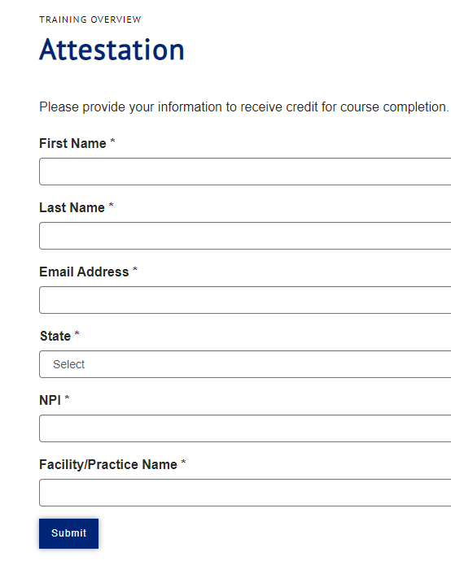
Dual Special Needs Plan Annual Model of Care Training
CMS requires all Special Needs Plans including DSNP to provide annual Model of Care (MOC) training to providers who routinely these patients –
It takes about 10 minutes to complete the course
IMPORTANT: You may take the training individually or you may complete the training as a group representative and share it with care providers in your group
MOC training must be completed annually by 12/31
Please note: There is no national MOC training because care management processes vary across insurers. This means you may be asked to complete multiple trainings as required by other insurers.
To access the MOC training online, go to:
Special Needs Plan Model of Care Provider Training (chameleoncloud.io)

Slide 6
2023 July
What’s New for Michigan?
https://www.uhcprovider.com/en/resource-library/news.html
Policy and Protocol Updates
Commercial | Medicare | Medicaid | Exchange Plans
Medical policy updates Reimbursement policy updates
Specialty Medical Injectable Drug program updates Pharmacy and clinical updates
Digital updates
Tools to help make credentialing faster and easier More claim letters going digital on July 14
Program and Product updates
The July 1 Preferred Lab Network list is available
Updated requirements for gastroenterology services
Prospero and Landmark combine to create one home-based care program

