Slide 1
Welcome!
Lakeland Care Network
Annual Payor Conference
October 19, 2022

Slide 2
Lakeland Care Network - Update
Welcome
Contracted payor list / website / provider directory
West Michigan ACO
Sunset of Affirmant
Monthly Payor Meetings
Process Improvements

Slide 3
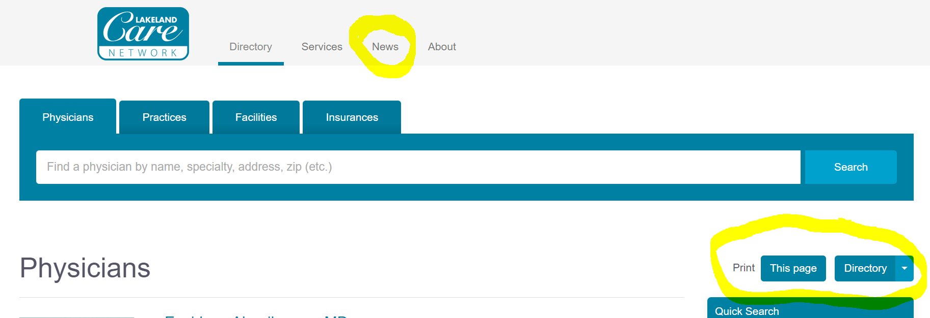
Lakeland Care Network – Website (lakelandcare.com)

Slide 4
Corewell Health – Benefits for 2023
Open enrollment starts 10/31/22
Refer care to Lakeland Care Network providers
Benefits for 2023 will be placed on LCN website

Slide 5
Quality & Care Management Team
Your experts in clinical transformation, integration, process and quality improvement in the following areas:
CMS Programs – ACO, Primary Care First
Payor Programs – PGIP, Priority Health, Humana, Meridian, UHC
Practice Transformation – Process & Quality Improvement
Patient Experience
Focus in 2023
See your patients
Monitor your hypertensive patients
Cost of Care
shllcquality@spectrumhealth.org or 269-985-4414

Slide 6
Employer Services
Population Health Management at the Workplace
Vaccination Programs (flu, Hep B, covid)
CPR/AED, First Aid, Bloodborne Pathogen Training
Executive Health
Occupational Medicine
Eric Muha, Manager, Employer Services
Notes:
Customizable wellness programs (love this)
Identify risk: Biometrics
Provide resources: health coaching, education and referral to PCP (Talking point – many people do NOT have a PCP, we connect people to your practices, refer to care mgt., )
Vaccination …
CPR… (talking point of CPR classes)
Health challenges (talking point on how they drive engagement)
Health education (talking points: Lunch & learns, cooking classes, myWeigh to Health, fitness classes., etc)

Slide 7
Lakeland Care Operations
List of contracted payors
Credentialing News
Expedited services
Notification of Changes
www.lakelandcare.com
News (today’s ppts!)
Search for providers/offices
Print a directory
Contracted payor list
Provider portal links

