Slide 1
Lakeland Payer Conference 2022
Presented by Provider Network Representative, Nancy Paskel
October 19, 2022

Slide 2
Secure Provider Portal
Meridian provider portal moved to Centene’s platform on April 1, 2022.
Driven by Tax ID Number (TIN)
Performs best in the current version of Chrome
Registration and access to our new website and portal opened on March 1, 2022, for Meridian and MeridianComplete (Medicare-Medicaid Plan) at provider.mimeridian.com.
Our Ambetter from Meridian website and portal registration can be accessed at ambettermeridian.com.
Ambetter was previously our Commercial/Marketplace product
Lakeland’s contract only includes Medicaid, MeridianComplete, and Ambetter from Meridian products.

Slide 3
Provider Portal Functions
Portal Features and Benefits:
Member Eligibility
Patient List (only PCP / PCP Organizations)
Viewing and Submitting Authorizations
Viewing Claims Information/status
Claim Submission
Patient Schedule of Benefits
Only available in the Ambetter from Meridian portal, under check eligibility-cost sharing. Benefit usage is also a good tool.
Once logged in, you can access the step-by-step guide, which provides instructions to navigate the portal. Secure Provider Portal Quick Start Guide

Slide 4
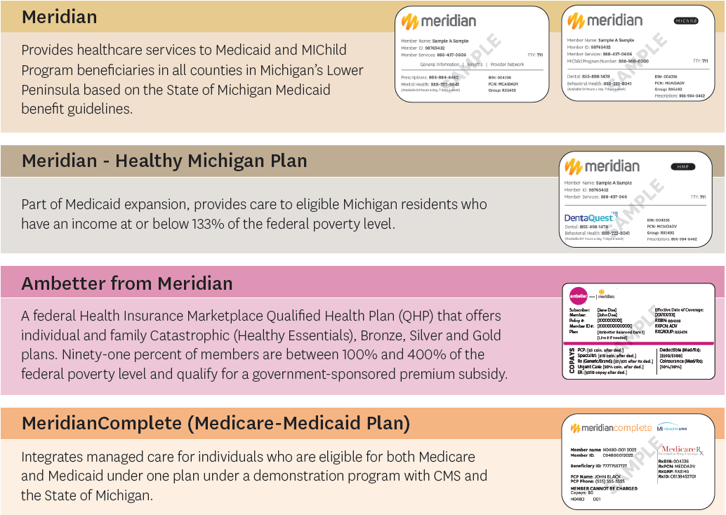
Member ID Cards
Our members will receive new member ID cards by April. You should confirm eligibility by using the new member’s number through the secure provider portal.
A handout will be available at the Meridian Table.

Slide 5
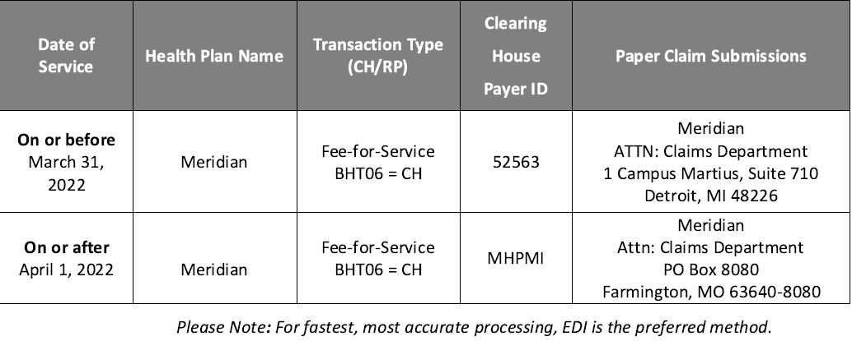
Claims Submissions
For more specific details, please visit mimeridian.com to access the Billing Manual.

Slide 6
Claims Submissions
To ensure you are sending your claims to the correct address, use the date of service or date of admission to determine where they should be sent.
Examples:
If you are submitting professional claims for date of service 3/30/2022, 4/2/2022, and 4/7/2022. The 3/30/2022 claim would be sent to 1 Campus Martius, Suite 710 Detroit, MI 48226 and the remaining two dates of service would be sent to PO Box 8080, Farmington, MO 63640.
Inpatient admissions that have start date prior to 3/31/2022 and extends through 4/1/2022 should be sent to 1 Campus Martius, Suite 710 Detroit, MI 48226. Inpatient Admission that have a start date on or after 4/1/2022 should be sent to PO Box 8080, Farmington, MO 63640.

Slide 7
Provider Appeals
Provider appeals (Medical Necessity Authorization Denials) will no longer be accepted via fax for dates of service April 1, 2022, and onward. Provider appeals must be submitted to the following address for review:
Post-Service Appeals (appeal for services that have been rendered)
For dates of service prior to April 1, 2022:
Meridian
Attn: Appeals Department
PO Box 44287
Detroit, MI 48244
Fax: 833-341-2044
For dates of service April 1, 2022, and onward:
Meridian
Attn: Appeals Department
PO Box 8080
Farmington, MO 63640-8080

Slide 8
Post-Payment Appeal Process
Process:
Submit in writing 120 days from last claim denial.
Please refer to the Provider Manual for process details and specifics per line of business.
Requirements:
Member name and ID number
Supporting clinical information
Reason for appeal
Date of service
Claim number (found on last claim denial or date service)

Slide 9
Real-Time Connectivity
Vendor Partner: Availity
Health Plan: Meridian
Phone Number: 1-800-282-4548
These services improve data interchanges, provides an innovative solution to provider requests and implement other HIPAA-compliant transactions in the future:
Real-time eligibility and claim status information – no waiting on the phone.
Low or no cost to the provider community.
Increased office productivity.
One-stop shopping – view eligibility and claim status information for all participating health insurance companies from a single website with a single login.

Slide 10
Electronic Funds Transfer & Electronic Remittance
For payments by Electronic Funds Transfer (EFT) and for Electronic Remittance Advice (835)/Explanation of Payment (ERA/EOP), please utilize Payspan®.
Create an account by registering at www.payspanhealth.com or calling 1-877-331-7154, option 1.

Slide 11
Payment Integrity Changes - Correct Code Editing
Meridian wants to inform you of correct code editing related changes as we have migrated to our new claims processing platform, Amisys. This change will address the growing problem of fraud, waste, and abuse (FWA) in health care.
On April 1, 2022, with the migration to Amisys, Meridian phased out both Change Healthcare Prepay Insight Supplemental Code Edits and Cotiviti Prospective Payment Management (PMM).
We have been utilizing Change Healthcare’s ClaimsXten, Cotiviti’s Coding Validation, as well as internal Payment Integrity editing solutions, to ensure accurate and precise correct code editing.
We have set up the above code editing programs for Meridian in conjunction with our corporate office, Centene Corporation, and our strategic business partners, Change Healthcare and Cotiviti, for their respective programs.
These programs will help protect Meridian from the unnecessary expenditures resulting from wastefully billed claims. The vendors will provide clinically based rule content to evaluate claims against complex payment and medical policies to ensure accurate reimbursement.
Since migrating to Amisys, some providers will observe that more exacting programs are now in place to assure that only accurately and properly coded and billed services will be reimbursed.
For more information on the correct code editing program, more details about the vendors mentioned above, as well as sourcing of the correct code editing, please visit the Meridian website at mimeridian.com.

Slide 12
Billing, Coding, and Reimbursement
Meridian follows CMS guidelines and MDHHS billing guidelines.
Claims and Provider Manuals can be found on the plan websites.
Please refer to these resources for guidance regarding specific services.
Claims Provider Manual
Provider Manual

Slide 13
Utilization Management Vendor Updates
The following vendors will no longer manage authorizations for Meridian effective April 1, 2022:
eviCore healthcare
HealthHelp
Active Vendors:
National Imaging Associates (NIA)
NIA will continue to manage non-emergent, advanced, outpatient imaging services, therapy services (PT/OT), as well as interventional pain management, which went live in 2021.
New Century Health
Effective April 1, 2022, New Century Health began managing prior authorizations for radiation therapy and medical oncology services for Meridian members.
Requests for dates of service April 1, 2022, and beyond should be submitted directly to New Century Health.
Please access the Bulletins page on our website for a detailed notification and delegated code list.
TurningPoint Health
TurningPoint will continue to manage select musculoskeletal procedures (Orthopedic and Spinal Surgical Procedures).

Slide 14
Prior Authorization Requirements
IMPORTANT:
Please refer to the authorization tools and resources available on each product website as auth requirements can vary based on the line of business
Please be aware that codes requiring prior authorization have been added and deleted. Check for requirements for any code on our website.
mimeridian.com/providers/preauth-check.html
ambettermeridian.com/provider-resources/manuals-and-forms/pre-auth.html

Slide 15
Monthly Provider Updates
Stay informed by signing up to receive our Monthly Provider Update!
You can sign up and find our monthly newsletter and supplemental bulletins on Meridian’s Bulletin page:
mimeridian.com/providers/bulletins.html

Slide 16
Pharmacy
The Pharmacy Benefit Manger (PBM) has changed to CVS.
Members will receive new ID cards.
For pharmacy self-administered medications, a prior authorization can be submitted electronically through covermymeds.
To register, please go to account.covermymeds.com.
The covermymeds account can be used by the provider to initiate, access, and submit prior authorization requests.
To see more information, visit: CoverMyMeds Provider Quick Start Guide

Slide 17
My Contact Information
Nancy Paskel
Phone: 313-820-2917
Email: nancy.paskel@centene.com

Slide 18
Thank you!

