Slide 1
Lakeland Care Network –
Payor Conference
(Part 2)
Jennifer S.
Kayaker
Sr. VP Client Solutions
Wednesday, October 19th

Slide 2
Claim Submissions
For EDI and Mailing Addresses, please view the back of the Member’s ID Card (Can Be Viewed on Portal Too)
Submission Mailing Addresses Vary by Plan Type
If Member ID Card is Unavailable, There is an Online Payor ID List Here:
Claims Payer List for UnitedHealthcare, Affiliates and Strategic Alliances (uhcprovider.com)

Slide 3
Claim Status
Claim Status Can Be Viewed Via the Provider Portal
“Track It” Tool
There are Self Paced and Instructor Led Training Courses Regarding Claims
Claims: Interactive Guide (chameleoncloud.io)

Slide 4
Authorizations
Authorizations Can Be Done Via the Provider Portal or Can Be Called In Via the Regular Customer Service Phone Number – 877-842-3210
There are Self Paced and Instructor Led Training Courses Regarding Authorizations
Prior Authorization and Notification | UHCprovider.com
Authorization Information is Now Paperless – Please Refer to the Document Library on the Portal for Correspondence

Slide 5
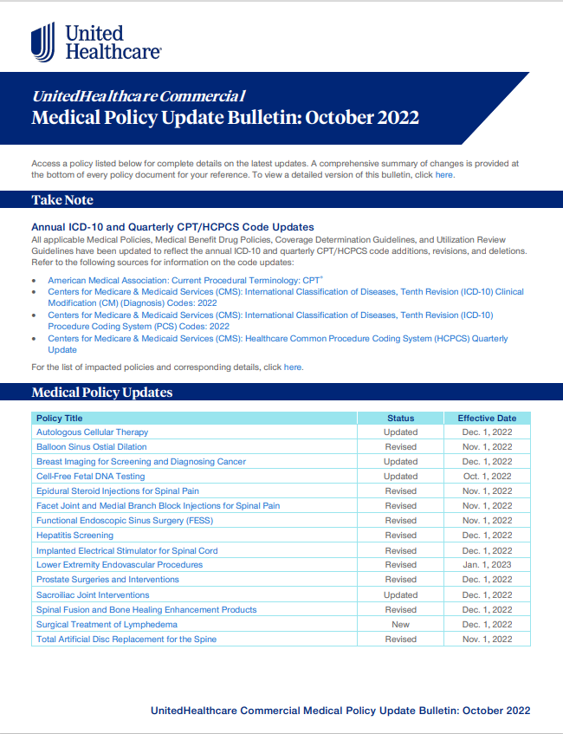
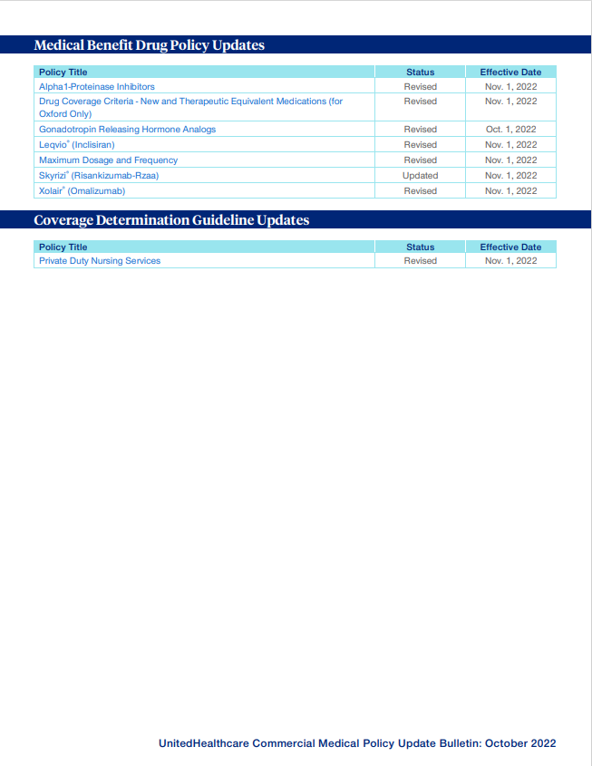
Medical Policy Updates
Medical Policy Updates: October 2022 | UHCprovider.com

Slide 6
Reimbursement Policy Updates
Reimbursement Policy Update Bulletins: October 2022 | UHCprovider.com

Slide 7
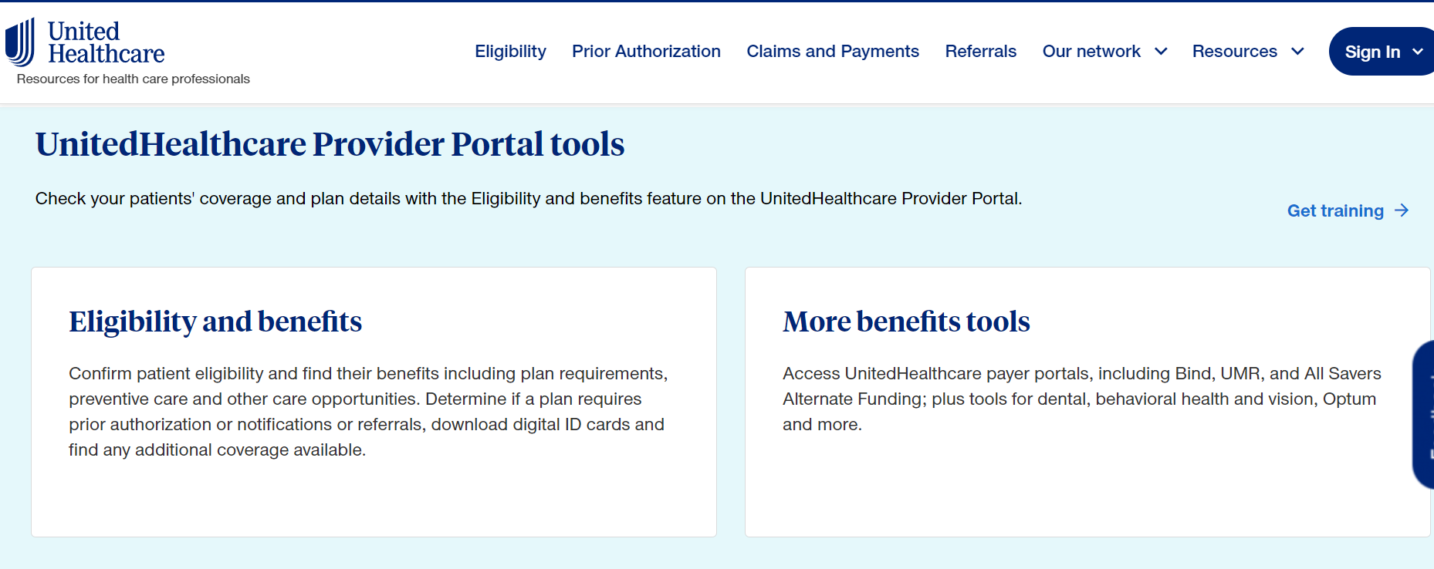
Online Tools – Eligibility and Benefits
Eligibility and Benefits Resources for Providers | UHCprovider.com

Slide 8
Online Tools – Prior Authorization and Notification
Prior Authorization and Notification | UHCprovider.com

Slide 9
Online Tools – Claims, Billing, and Payments
Claims, Billing and Payments | UHCprovider.com

Slide 10
Online Tools – Referrals
Referrals | UHCprovider.com

Slide 11
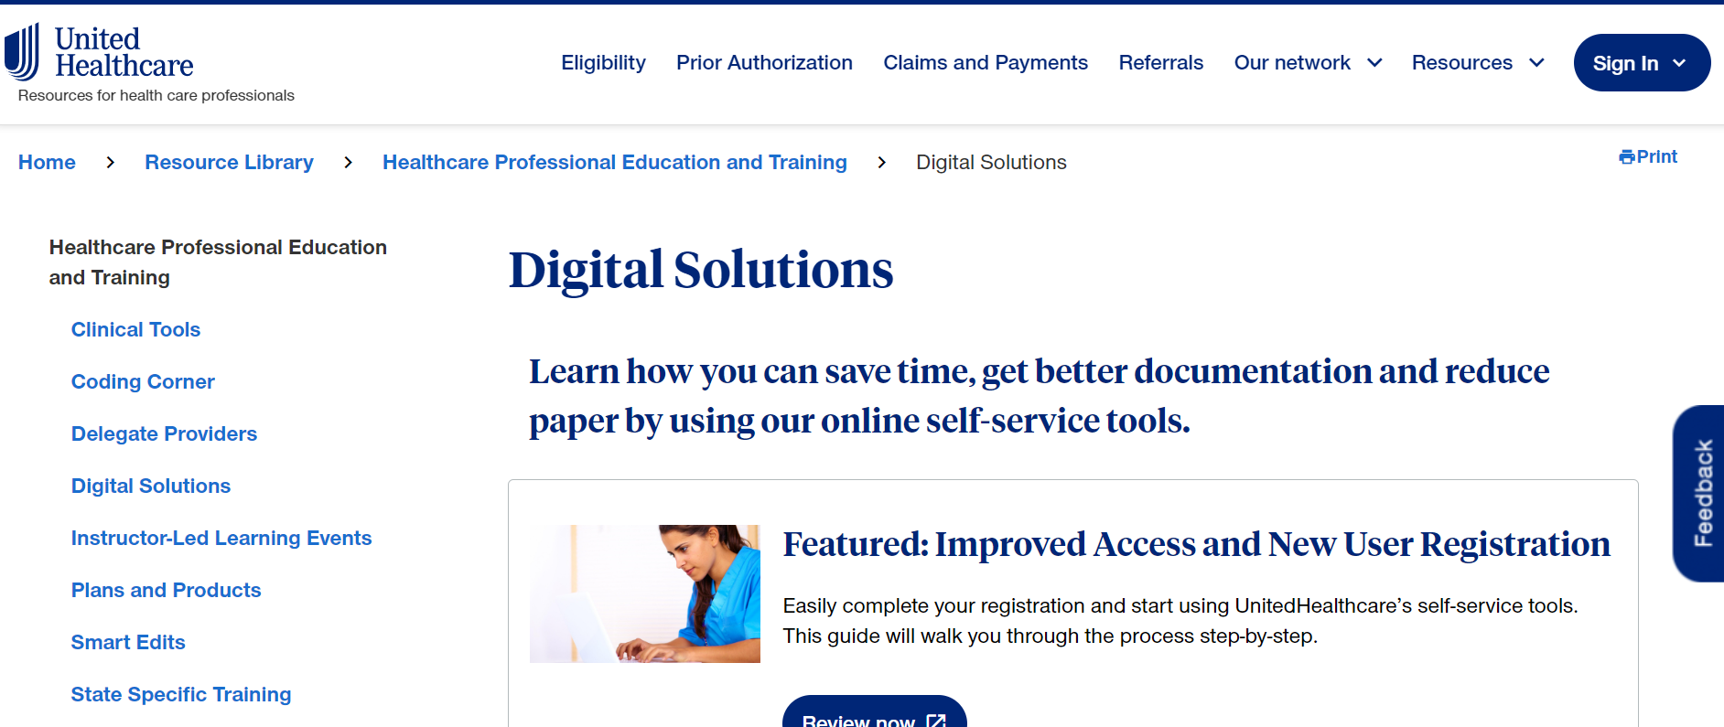
Self-Paced Training Sessions & User Guides
Digital Solutions | UHCprovider.com

Slide 12
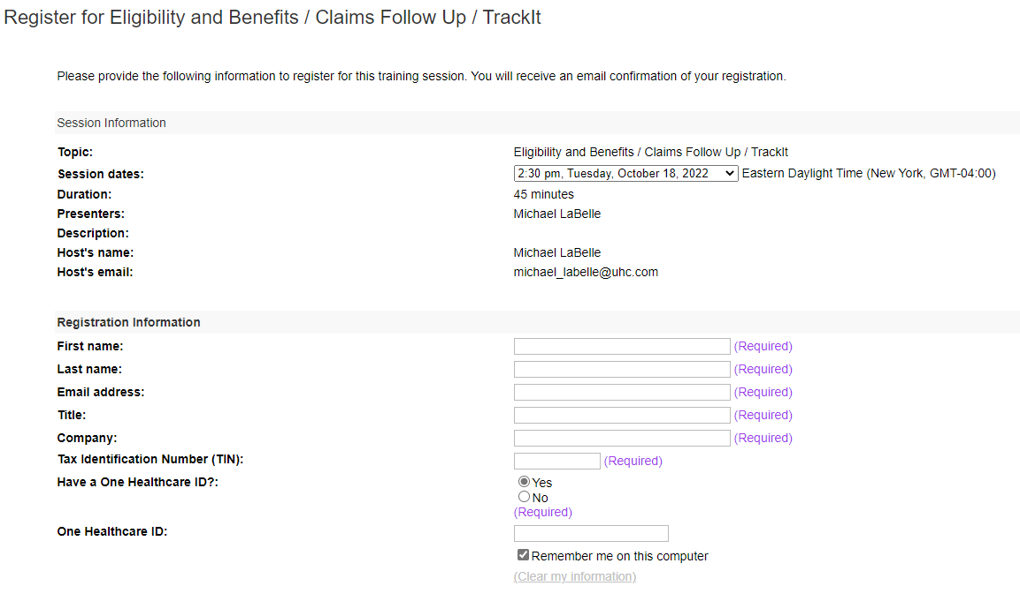
Live Training Sessions
Instructor Led Trainings | UHCprovider.com

Slide 13
Claims Service Model
Claims: Interactive Guide (chameleoncloud.io)
Review Claim Online
Request Online Reconsideration, Call Customer Service and Request a Reconsideration (877-842-3210), or Submit a Corrected Claim
Contact your Advocate (Susan) - susan_f_anspaugh@uhc.com
You are required to try the online reconsideration process or the customer service resolution option before submitting issues to this option.
Appeal – Appeal Addresses for All Lines of Business Can be Found in the Administrative Guide

Slide 14
Questions?
Any Questions, please contact Susan Anspaugh
952-406-3493
susan_f_anspaugh@uhc.com

