Slide 1
Meridian
2023 LCN Conference

Slide 2
Meridian Contacts
C’Mone Johnson
Provider Network Specialist II
Cmone.c.johnson@mhplan.com
313-670-2650
Melissa Pace
Supervisor, Provider Relations
Melissa.pace@mimeridian.com
947-517-5625
Alexandra Leas
Director, Provider Relations
Alexandra.leas@mimeridian.com
313-400-1788

Slide 3
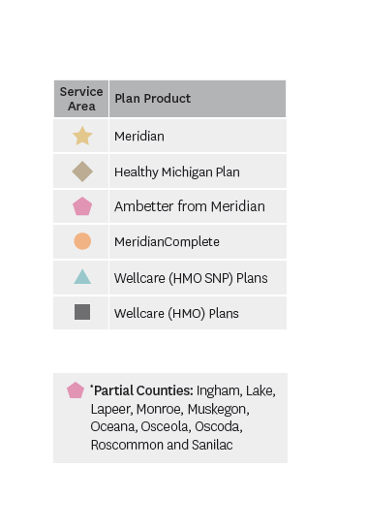
Service Area and Products

Slide 4
Ambetter Virtual Access

Slide 5
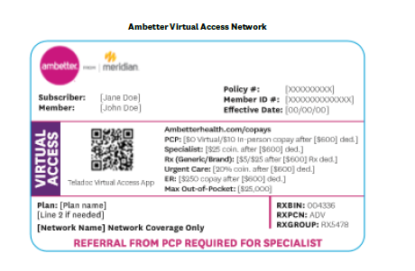
Ambetter Virtual Access
Effective January 1st 2023, select Ambetter providers will be able to participate in the new Ambetter Virtual Access provider network.
PCP-Centric network, where members are automatically assigned to a Virtual Teladoc PCP
For services to be covered, they must be provided by or referred by a PCP.
As a PCP, please ensure you are submitting referrals anytime a Virtual Access member requires care beyond your scope
Members assigned to a Teladoc PCP will need a referral to see a provider in office

Slide 6
Ambetter Virtual Access
PCP Referrals
Referrals are submitted through the Secure Provider Portal
Ambetter will intake the referral and ensure claims are paid accordingly.
Providers submitting claims related to referrals must include the correct Referral ID # on the claim

Slide 7
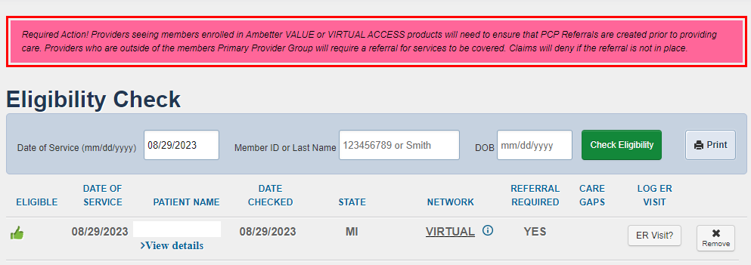
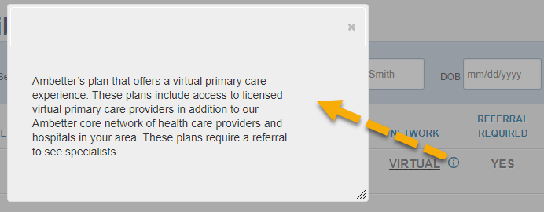
Ambetter Virtual Access

Slide 8
Ambetter Virtual Access

Slide 9
Medicaid Provider Portal Redesign

Slide 10
Portal Claims Redesign Overview
Newly created Claims Dashboard enables quick access to most relevant claims information on one page.
All-New Claims Status Tiles and Pages, with filter, row count, and pagination capabilities.
Ability to search for claims by Claim Number, up to 10 claims at once, from Claims Dashboard and Advanced Search.
Expanded Claim Details page displays all reference numbers associated to a claim (i.e., Reconsideration Number, Appeal Number, etc.)

Slide 11
Claims Dashboard- Manage Finances
New location and categorization of claim-related financials.
“View all EOPs” links to existing Payment History tab and information
Batch Claims Reports link provides quick access to EDI Response Report (i.e., 999, TA1, etc.).
Claim Audit Tool (where available) changed from a tab to a link.

Slide 12
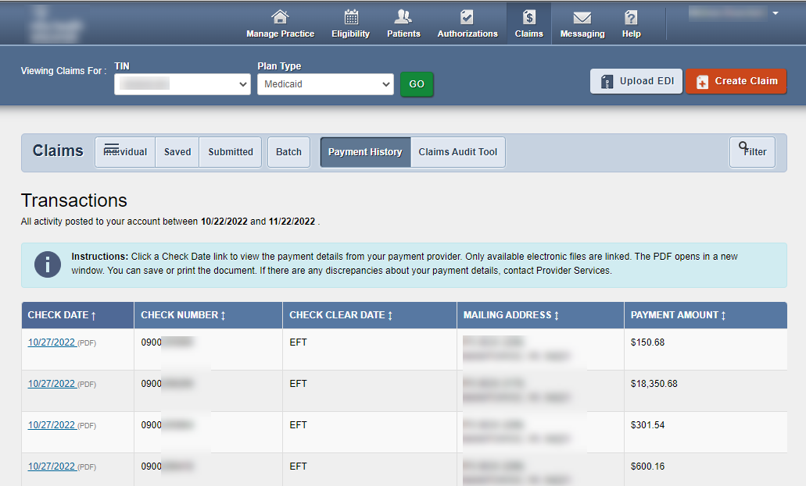
Claims Dashboard- Manage Finances
To access Explanation of Payment (EOP) information, under Manage Finances, click View all EOPs. The legacy Payment History tab displays.
Click Claims at the top of any page to return to Claims Dashboard
Check dates underlined in blue will open up EOP

Slide 13
Claims Dashboard- Resource link
Newly added claim-related Resources.
Link to [Portal] Updated Instruction Manual.
Link to EDI Guide (Medicare Claims Processing Manual).
Link to CMS 1500 Claim Form (image for reference only).
Link to CMS UB-04 information.

Slide 14
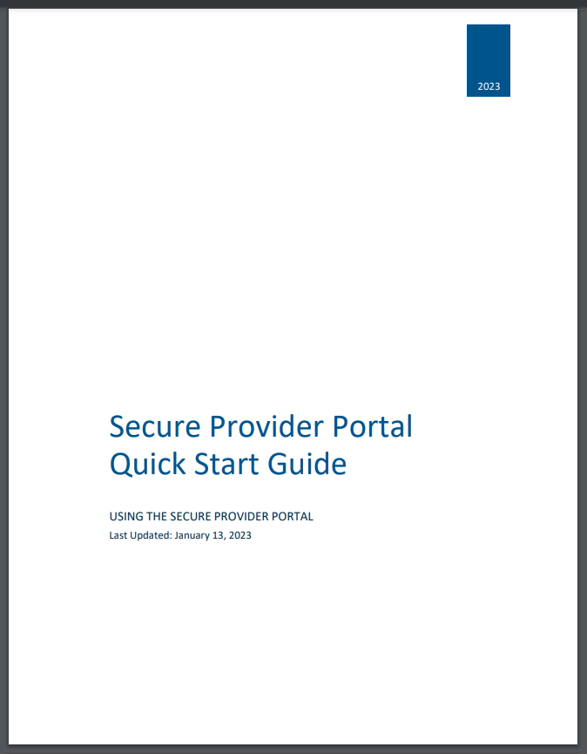
Claims Dashboard- Instruction Manual
Click the Updated Instruction Manual (PDF) link under Resources to access the updated manual, which includes Portal Claims Redesign information.
The manual will open in a new tab or window.

Slide 15
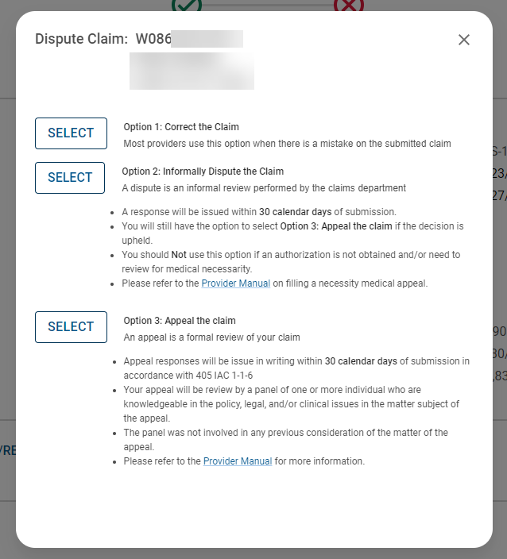
Appeals
Providers can now submit appeals in our provider portal!

Slide 16
Appeals
Types of Issues Providers can appeal:
Post-Service: An appeal of services that were denied or reduced because they did not meet a specific criteria, policy, or guideline and have a denied authorization on file.
Administrative: An appeal by a provider of a claim/service denied for failure to authorize services according to timeframe requirements.
Provider’s can locate manuals on website for more information regarding time frames, documents needed etc.

Slide 17
Portal Self-Service Options
Member Eligibility
Green thumbs up if member is eligible
First time claim submission
Reconsiderations
Appeals
Authorization Submission
Can also fax in PA requests. Refer to Integration letter for fax numbers
Check Detail
Claim Detail
Incentive Payment Check Detail

Slide 18
Claims/Authorizations

Slide 19
Claim Submission
Mailing Address
PO Box 8080 Farmington, MO 63640-8080
Electronic Claim Submission
Meridian utilizes Availity as our clearinghouse
Customer Support: 800-282-4548
Payer ID: MHPMI
Provider Portal Claim Submission
Claims can be submitted via our Provider Portal
Provider.mimeridian.com

Slide 20
Payspan Sign-Up
Meridian offers a free solution for EFT and electronic remittance advice (835/ERA/EOP) through Payspan.
Create an account by registering at www.payspanhealth.com
Request a registration code: Payspanhealth.com/RequestRegCode
Payspan Provider Support
1-877-331-7154, Option 1
providersupport@payspanhealth.com

Slide 21
Prior Authorizations
Provider’s can check the requirements for any code on our website: mimeridian.com/providers/preauth-check.html
Inpatient/Outpatient Fax forms on website
PA Grace Period Change
Authorizations can be updated for changes in DOS, CPT codes, or physicians within 30 days or original DOS.
Must be updated before claim is billed
Active Vendors
NIA: Non-emergent, advanced, outpatient imaging services, therapy PT/OT, as well as interventional pain management
Website: www1.radmd.com/radmd-home.aspx
TurningPoint Health: Orthopedic and Spinal Surgical Procedures
Website: myturningpoint-healthcare.com/
Meridian can set up conference calls with authorization vendors if there are any questions/concerns

Slide 22
Meridian Bulletins

Slide 23
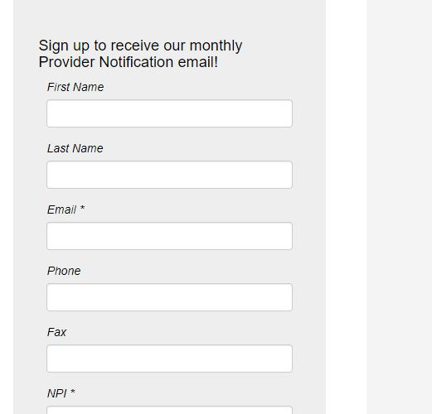
Important Updates
Sign up to receive monthly bulletins e-mailed directly to you!
mimeridian.com/providers/bulletins.html

Slide 24
October Updates
Cultural Competency Training
Please be sure to stay up to date on required trainings including Cultural Competency. You can find training attestation forms at mimeridian.com> Providers > Provider Training > Annual Training
Provider Satisfaction Survey
Surveys going out this month- we hope you’ll take a moment to share your feedback!
Monthly Webinars
First Wednesday of every month from 9am-10am EST. Provider Network Team will discuss various topics.
Zoom information is on flyer shared

Slide 25
Important Links/Numbers
Member Services: 888-437-0606
Provider Services: 888-773-2647
Transportation Services: 800-821-9369
Manuals/Forms: mimeridian.com > For Providers < Documents and Forms
Notification of Pregnancy
Provider Manual/ Claims Manual
Inpatient/Outpatient Authorization Form
Payment Policies
Quality Guidelines

Slide 26
Credentialing

Slide 27
Credentialing
All Provider add/terms/updates are worked monthly by our delegated credentialing team. Any concerns with a provider’s status can be sent directly to C’Mone & Melissa.

