Slide 1
Lakeland Care Network Payor Conference October 18th, 2023

Slide 2
Table of Contents
Member ID Cards and Plans
Verify Doctor Network Status
Online Tools – UHCProvider.com
Network News
Eligibility and Benefits
Authorizations
Claims – Submission and Status
Claims – Remediation and Appeals
Track It
Document Library
Referrals
Training – Self Paced and Live Options
Questions – Chat Feature

Slide 3
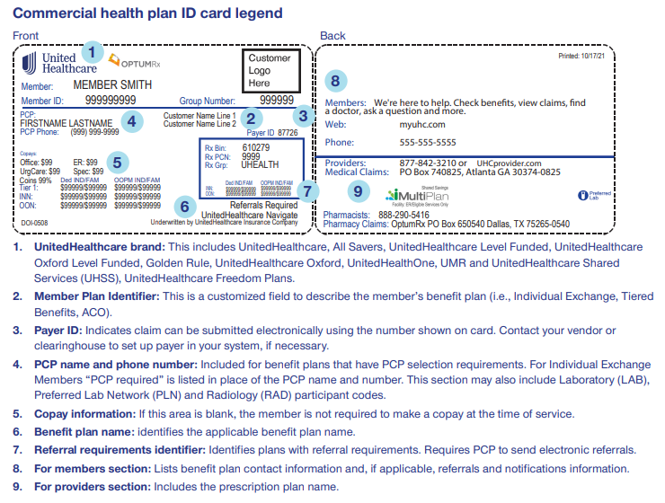
ID Cards and Plans
Lakeland Care Plans:
Commercial

Slide 4
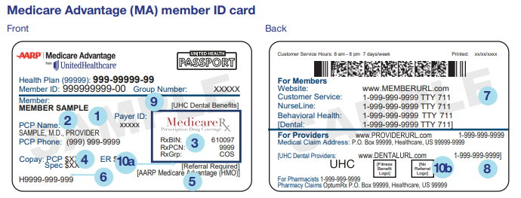
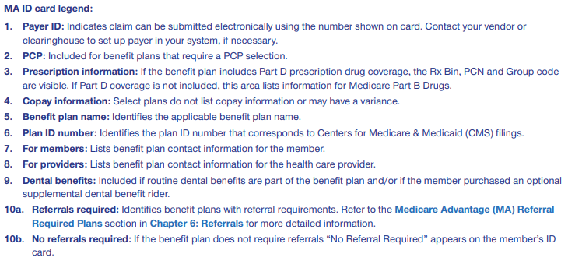
ID Cards and Plans
Lakeland Care Plans:
Medicare Advantage

Slide 5
ID Cards and Plans (Continued)
Lakeland Care Plans:
Ucard – Medicare Advantage

Slide 6
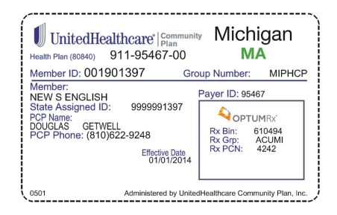
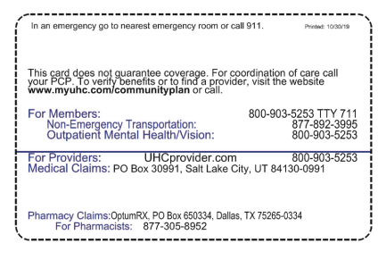
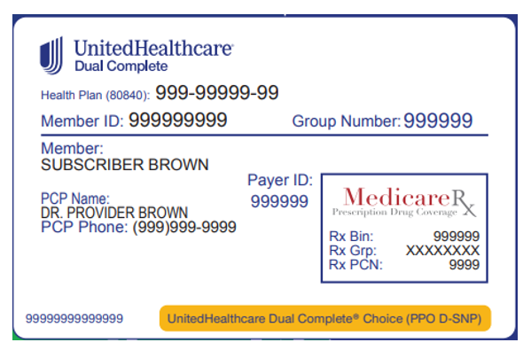
ID Cards and Plans (Continued)
Lakeland Care Plans:
Medicaid and DUAL

Slide 7
Verify Doctor Network Status
www.myuhc.com (Member Facing Website)
Can Search By Plan Type and Geographic Location
for Participating Providers
www.uhcprovider.com (Provider Facing Website)
Login to Provider Portal
Search for Member/Eligibility
Confirm Participating Status Based on Member’s Plan

Slide 8
Online Tools – www.UHCProvider.com
Save time, get better documentation and reduce paper by using our online tools.
Check eligibility and beneﬁts information
Submit prior authorization requests
Access items in Document Library
Access claims information like status updates, reconsiderations and appeals
Website Training Resources:
https://www.uhcprovider.com/en/resource-library/training.html
Self Paced Online Courses (Digital Solutions)
Instructor Led Courses (Learning Events)

Slide 9
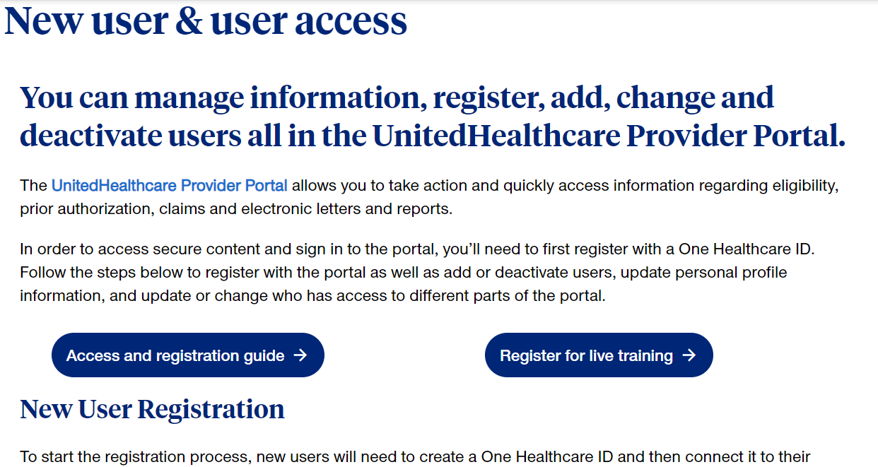
Online Tools – User Access
https://www.uhcprovider.com/en/access.html

Slide 10
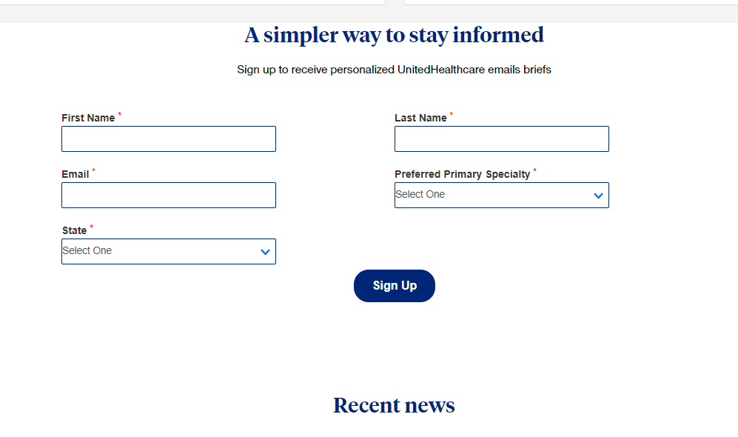
Online Tools - Join Network News
https://www.uhcprovider.com/en/resource-library/news/news-subscribe.html

Slide 11
Online Tools – Eligibility and Benefits
https://www.uhcprovider.com/en/patient-eligibility-benefits.html
Benefits and Features
Check member eligibility
View, download, save the ID card
Find the member’s cost share
View coverage details and limits
View detailed benefits information
Determine network and tier status
View previous member benefit plans
View preventive care opportunities for some members
If referrals, notification and prior authorization are needed
Therapy accumulator information

Slide 12
Online Tools – Prior Authorization and Notification
https://www.uhcprovider.com/en/prior-auth-advance-notification.html
Benefits and Features
Determine if notification or prior authorization is required
Submit a new request
Check the status or update a request
Upload clinical notes or attach medical records
Provide pertinent clinical information

Slide 13
Authorizations
Authorizations Can Be Done Via the Provider Portal or Can Be Called In Via the Regular Customer Service Phone Number – 877-842-3210
There are Self Paced and Instructor Led Training Courses Regarding Authorizations
https://www.uhcprovider.com/en/prior-auth-advance-notification.html
Authorization Information is Now Paperless – Please Refer to the Document Library on the Portal for Correspondence

Slide 14
Online Tools – Claims, Billing, and Payments
https://www.uhcprovider.com/en/claims-payments-billing.html
Benefits and Features
View claims information for multiple UnitedHealthcare® plans
Access letters, remittance advice documents and reimbursement policies
Submit additional information requested on pended claims
Flag claims for future viewing
Submit corrected claims or claim reconsideration requests
Receive instant printable confirmation for your submissions

Slide 15
Claim Submissions
For EDI and Mailing Addresses, please view the back of the Member’s ID Card (Can Be Viewed on Portal Too)
Submission Mailing Addresses Vary by Plan Type
If Member ID Card is Unavailable, There is an Online Payor ID List Here:
https://www.uhcprovider.com/content/dam/provider/docs/public/resources/edi/Payer-List-UHC-Affiliates-Strategic-Alliances.pdf

Slide 16
Claims Service Model
https://chameleoncloud.io/review/3094-5ef4dd188ef86/prod
Review Claim Online
Request Online Reconsideration, Call Customer Service and Request a Reconsideration (877-842-3210), or Submit a Corrected Claim
Click to Chat - sign into the portal, UHCprovider.com and click Sign In at the top-right corner. Then, enter your One Healthcare ID. After signing into the portal, chat can be accessed on the Contact Us page, 7 a.m.–7 p.m. CT, Monday–Friday. Our knowledgeable advocates are ready to offer support
Appeal – Appeal Addresses for All Lines of Business Can be Found in the Administrative Guide

Slide 17
Online Tools – Track It
https://www.uhcprovider.com/en/resource-library/provider-portal-resources/trackIt.html
Benefits and Features
Serves as your daily to-do list
Your personal assistant where you manage email notifications
An automatic reminder tells you we are missing some information
View appeal decision letters, prior authorization and clinical letters
Take action on claims, prior authorizations, referrals
Upload documents
Access from your Action Required Bar or the TrackIt icon

Slide 18
Online Tools – Document Library
https://www.uhcprovider.com/en/resource-library/provider-portal-resources/document-library.html
Benefits and Features
View and print your documents
Assign, manage and comment on documents using Teams View
Download letters and provider remittance advice (PRAs) for up to 24 months
Search any 90-day period, for up to 2 years
Customize your view
Manage multiple documents at once
See your most recently added documents
Mark letters and documents as read/unread

Slide 19
Online Tools – Referrals
https://www.uhcprovider.com/en/referrals.html
Benefits and Features
Find out if a referral is needed
Submit a referral request and receive a confirmation number
Check the status of a referral request
View, print or save confirmation numbers and timelines for submitted referrals

Slide 20
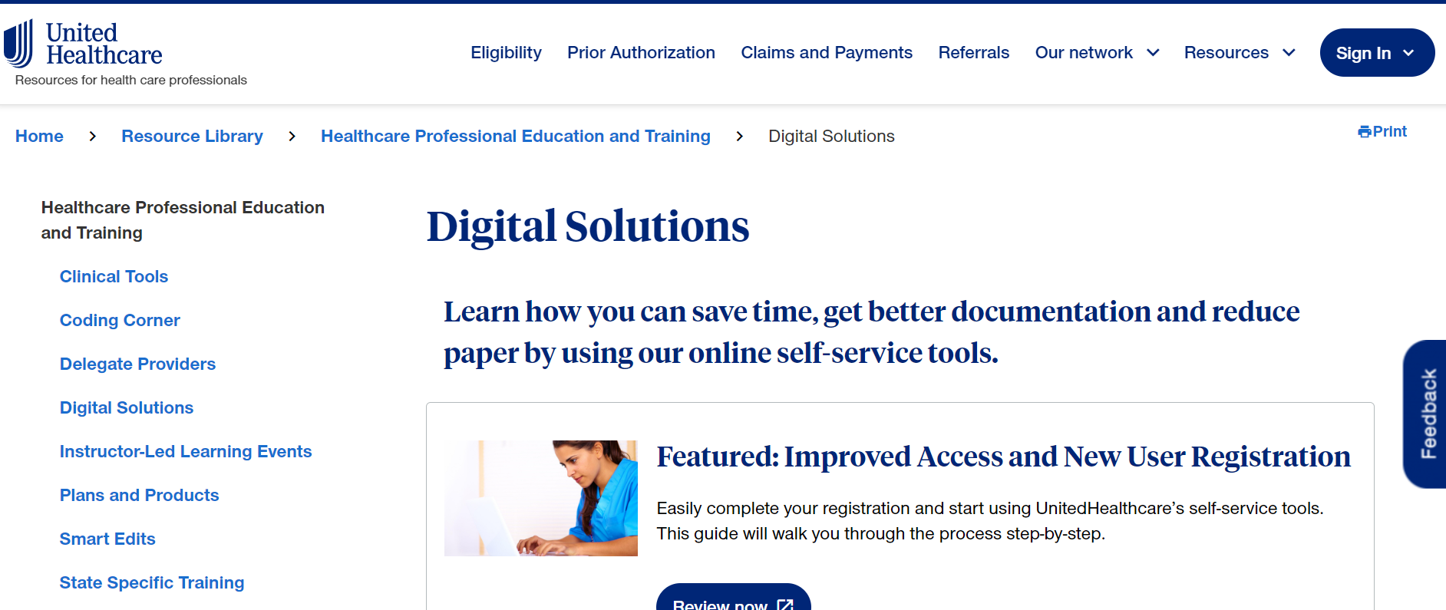
Self-Paced Training Sessions & User Guides
https://www.uhcprovider.com/en/resource-library/training/digital-solutions.html

Slide 21
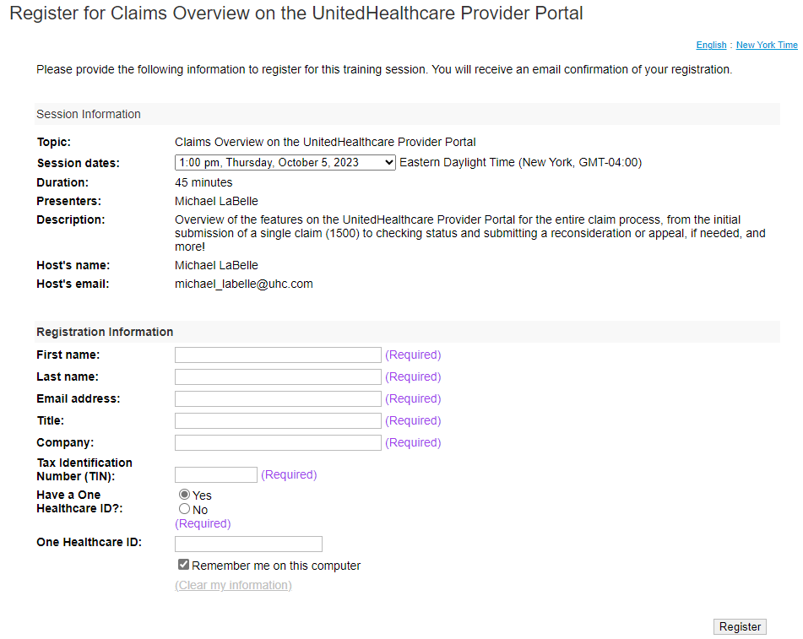
Live Training Sessions
https://www.uhcprovider.com/en/resource-library/training/instructor-led.html

Slide 22
Questions?
Do you need answers quickly but not sure where to find them?
Click to Chat - Our chat feature in the UnitedHealthcare Provider Portal has you covered.Our knowledgeable advocates are ready to offer support. When you pop into chat, not only will you get the support you need, you also may streamline your administrative processes.
Click to Chat - Sign into the portal, UHCprovider.com and click Sign In at the top-right corner. Then, enter your One Healthcare ID. After signing into the portal, chat can be accessed on the Contact Us page, 7 a.m.–7 p.m. CT, Monday–Friday.

